Slide 1

A presentation on Major Project
VIDEO CLASSIFICATION AND SIMILAR VIDEO RECOMMENDATION SYSTEM
Under the Esteemed Guidance of
_{K. Deepika M.Tech}
Assistant Professor
Presented By
1. Vaddella Mohan - 20BQ1A4259
2. Sheela Sai Kumar - 20BQ1A4251
3. Thota Hemanth Krishna - 20BQ1A4256
4. Kakarla Bhargav - 20BQ1A4226
Department of COMPUTER SCIENCE ENGINEERING – ARTIFICIAL INTELLIGENCE & MACHINE LEARNING
Vasireddy Venkatadri Institute of Technology
Pedakakani Mandal, Namburu, Gunturu-522508

Slide 2
Contents of Presentation
Abstract
Introduction
Existing System
Proposed System
Design of the Project
Module Specifications
Hardware and Software Requirements
Outputs
Conclusion

Slide 3
Abstract
The digital age has created mountains of video content, making organization and retrieval challenging. Our research tackles this issue by developing a video classification model for the Indian Space Research Organization (ISRO) using Long-term Recurrent Convolutional Networks (LRCN). The ‘Annoy’ algorithm also serves as a recommendation system, suggesting similar videos based on user interest. Our proposed video classification system for identifying action sequences utilizes two key methodologies. LRCN Model: The system breaks down videos into frames, extracts spatial features with CNN, and captures temporal context with LSTM. Annoy Algorithm: The system pre-maps existing ISRO videos using their extracted features. The similar videos are then recommended to the user for a better experience. Our LRCN video classification model excelled with a 67% accuracy on the ISRO dataset. Training and Validation Loss curves demonstrate a trend, suggesting the model successfully minimized error during training and generalizes well to unseen data. Our research demonstrates the power of Neural Networks like LRCN in Video Classification. To unlock their full potential: Include diverse ethnicities for broader representation and improved model accuracy in activity recognition. Continuously expand datasets, refine models, and explore new applications to push the boundaries of video category recognition technology. Extend the model beyond the current five categories to enhance its scope.

Slide 4
Introduction
At the heart of technology's progress, deep learning and video sorting come together, showcasing innovation by unraveling complex data patterns similar to how the human brain works.
Exploring deep learning's influence on video sorting leads us on a quest for knowledge and innovation, where powerful models like LRCN automatically detect complex features from videos, streamlining classification and enhancing content representation.
Deep learning models, like CNNs and LSTMs, go beyond still features to understand the timing of video events, improving accuracy in tasks like recognizing actions and detecting events.
Deep learning models can handle different types of videos, adapting well to diverse data and fostering strong classifiers, paving the way for exploration and innovation in video sorting.
Deep learning's unmatched accuracy makes it essential for precise video sorting in various fields, from security to healthcare, driving technological progress and reshaping industries.
Additionally, the ‘Annoy’ algorithm serves as a recommendation system, suggesting similar videos based on user interest.

Slide 5
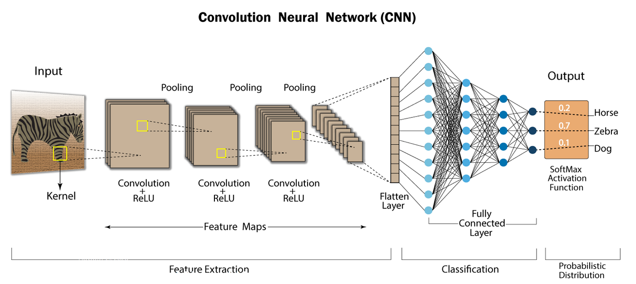
Existing System
Human action recognition using UCF101 dataset involves analyzing video sequences to classify actions or activities.
Similar to video classification, this task utilizes convolutional neural networks (CNNs) and recurrent neural networks (RNNs), such as long short-term memory (LSTM) networks.
CNNs extract spatial features from individual frames, while RNNs capture temporal dynamics.
Combining CNNs and RNNs achieves state-of-the-art performance in tasks like human action recognition and video classification.

Slide 6
Limitations
Computational Intensity: Processing video data using CNNs and RNNs can be computationally intensive, requiring significant resources for training and inference, which may pose challenges for deployment in resource-constrained environments.
Lack of Real-time Processing: The computational complexity of the existing system may hinder its ability to perform real-time video classification, limiting its usefulness in applications requiring immediate decision-making based on video content.
Sensitivity to Noise and Variability: The performance of the system may degrade in the presence of noise or variability in video data, as it may struggle to distinguish relevant patterns from irrelevant distractions.
Limited Generalization: While the system achieves state-of-the-art performance on the UCF101 dataset, its ability to generalize to unseen or diverse video datasets may be limited, potentially hindering its effectiveness in real-world scenarios.

Slide 7
Literature Review
Title | Author | Methodology | Limitation | Accuracy | Published Year | Link to Paper
X3D: Expanding Architectures for Video Recognition | Christoph Feichtenhofer | Stepwise Network Expansion, Feature Selection | Complex Architecture | 72% | 2020 | X3D Base Paper
A Deep Learning Approach for Video Classification | Dr. T. Raghunadha Reddy, P. Sreekari | LSTM, NLP | Suitable for only videos containing text | 97.92% | 2023 | NLP Base Paper
A Video Classification Framework Based on Cross-Modal Fusion | Nuo Pang, Songlin Guo, Ming Yan, Chien Aun Chan | Cross-modal fusion, BERT, 3D-ConvNet, Two-Strem, SlowFast | Not Suitable for our dataset | 90% | 2019 | Cross-Modal Fusion Base Paper

Slide 8
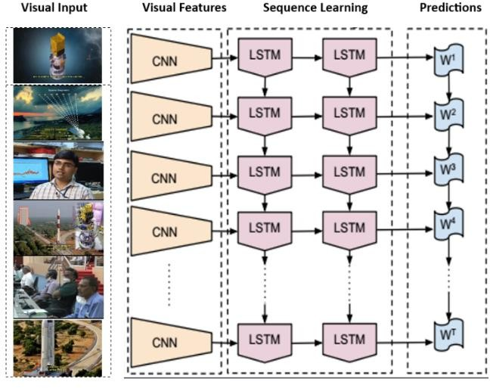
Proposed System
Objective: Categorize videos by extracting frames and generating feature vectors to identify action sequences.
Architecture: Integration of Long Short Term Memory (LSTM) and Convolutional Neural Network (CNN) models for improved spatial and temporal properties.
Fig: LRCN Architecture
Fig: LRCN Architecture Video Categorization: Accomplished by removing frame characteristics and considering variables like width, height, and sequence duration.
Model Components: Time-distributed 2D convolutional layer, max-pooling layers, dropout layers, additional convolutional layers with increasing filter sizes, and a flatten layer.
Temporal Analysis: Long Short-Term Memory (LSTM) layer captures intricate temporal dependencies within video sequences.

Slide 9
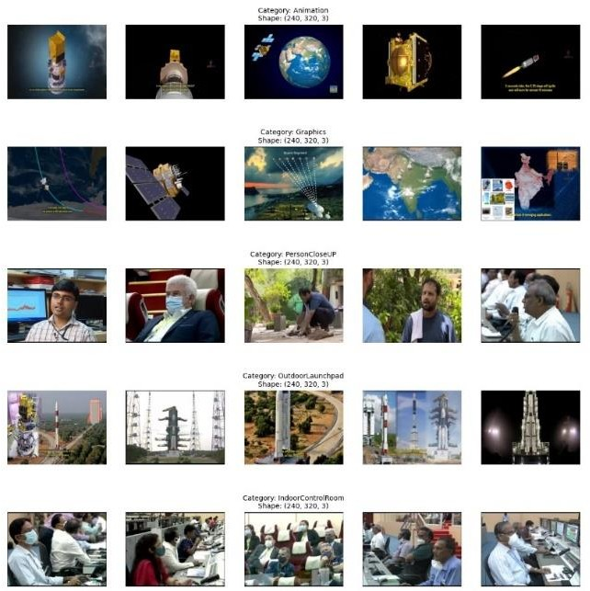
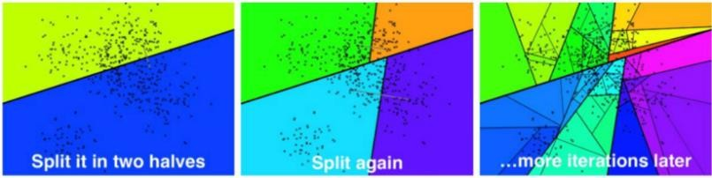
Output Generation: Dense layer with softmax activation function generates predictions for various classes.
Dataset: Utilization of ISRO Dataset for video classification.
Fig: ISRO videos 5 videos for each Category
Results: Achieves a 67% prediction accuracy for action sequence probability.
Recommendation System: Alongside classification, video recommendations based on input videos or images are provided using Annoy.
Fig: Annoy Algorithm working principle

Slide 10
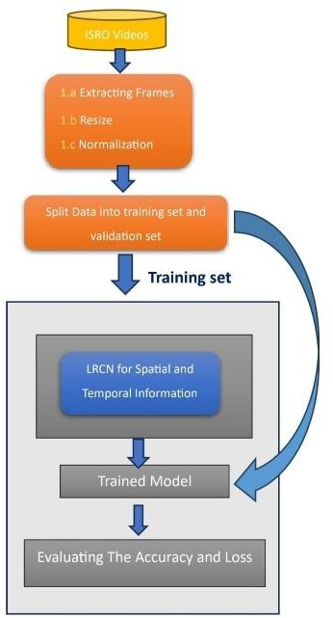
Design of the Project
Validation set
Fig: Flowchart of Proposed System

Slide 11
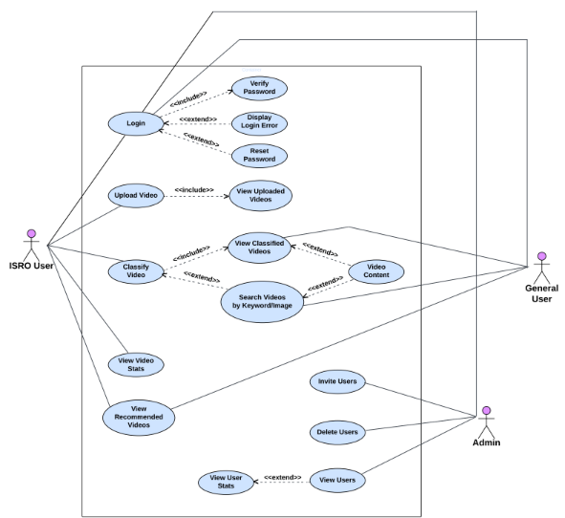
UseCase Diagram

Slide 12
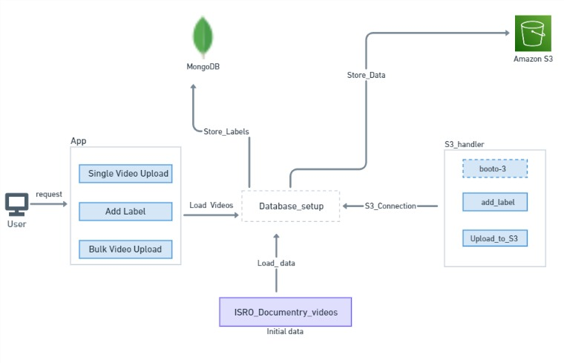
3 – Pipeline Architecture
Data Collection Pipeline

Slide 13
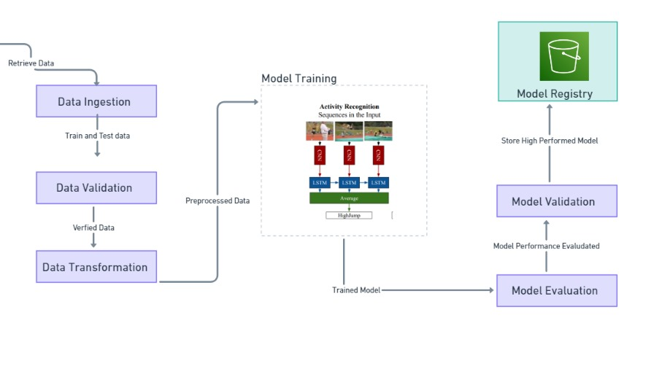
Training Pipeline

Slide 14
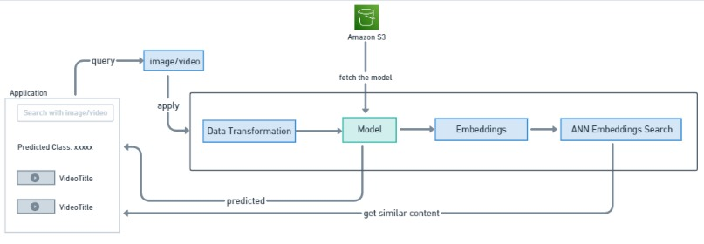
Prediction Endpoint

Slide 15
Module Specifications
The project includes Modules such as:
Deep Learning Models:
i) Classification Model
ii) Recommendation Engine
Frontend
Database
Backend

Slide 16
Software & Hardware Requirements
Deep Learning Model Implementation:
Anaconda
Google Colab
Tensorflow
Numpy
Pandas
Open CV
Frontend Implementation:
React JS
Tailwind CSS
Database:
MongoDB Atlas
Backend Implementation:
Node JS
Express JS
Python
Django
Jinja2

Slide 17
Cloud Services:
Amazon S3
Amazon IAM
Amazon EC2
Amazon VPC
Amazon EKS
Development Tools:
VS Code
Postman API
Docker
Kubernetes
FastAPI

Slide 18

GUI Screens
Home

Slide 19
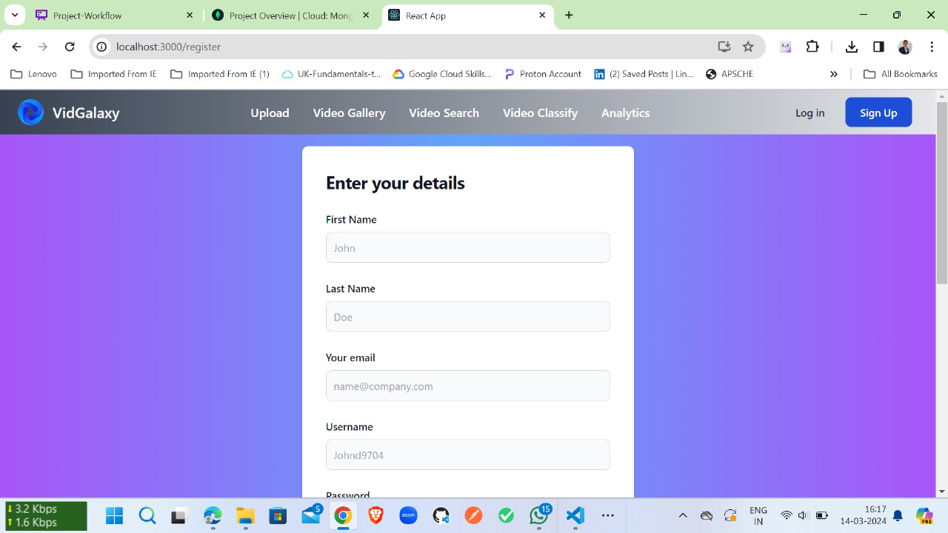
Sign-Up1

Slide 20
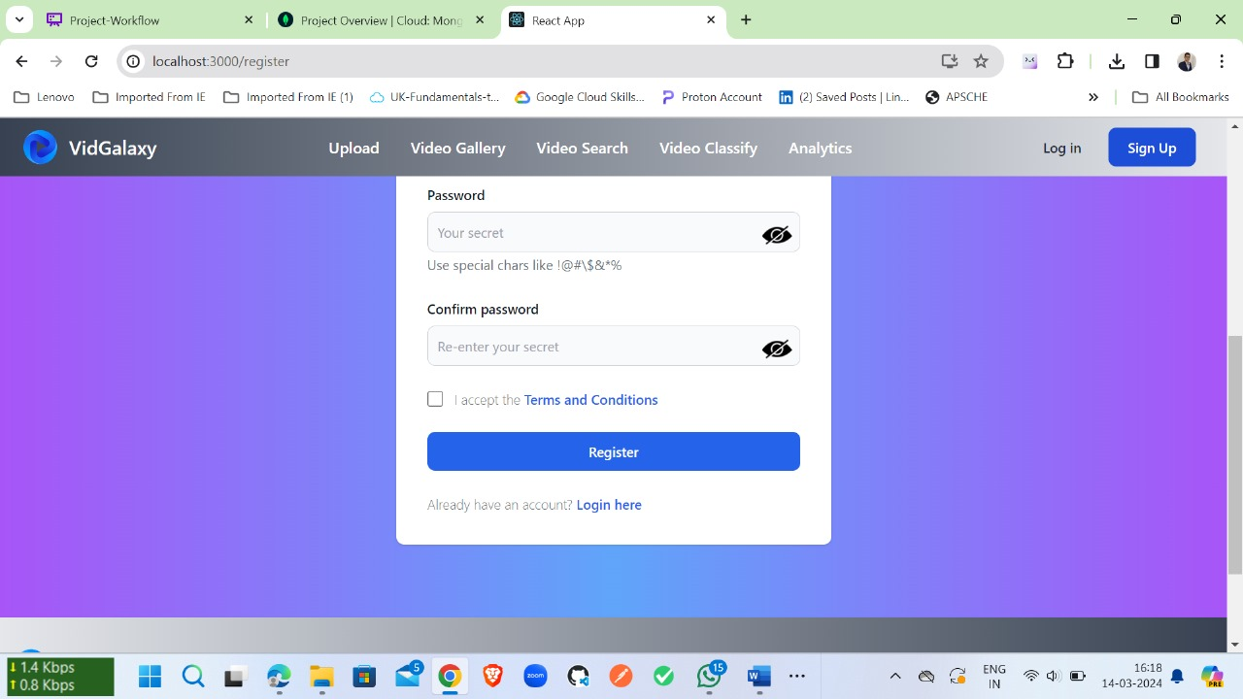
Sign-Up2

Slide 21

Login

Slide 22
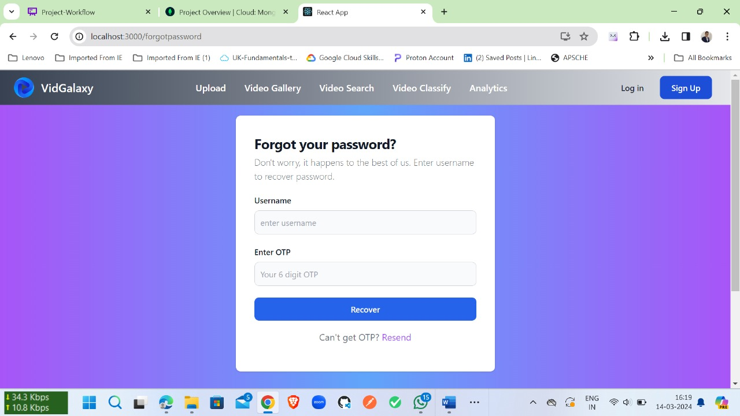
Forgot Password

Slide 23

OTP Verification

Slide 24
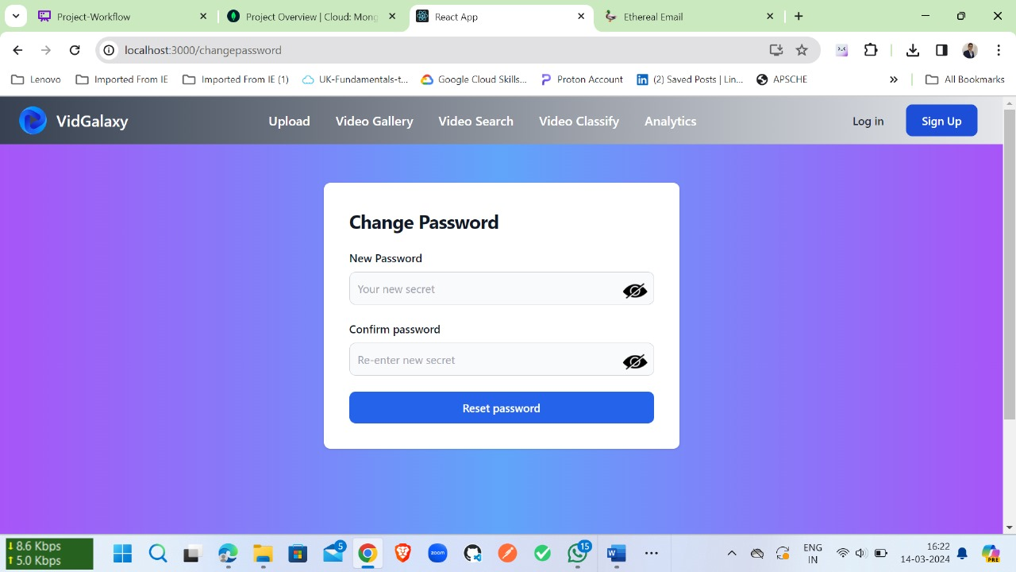
Reset Password

Slide 25
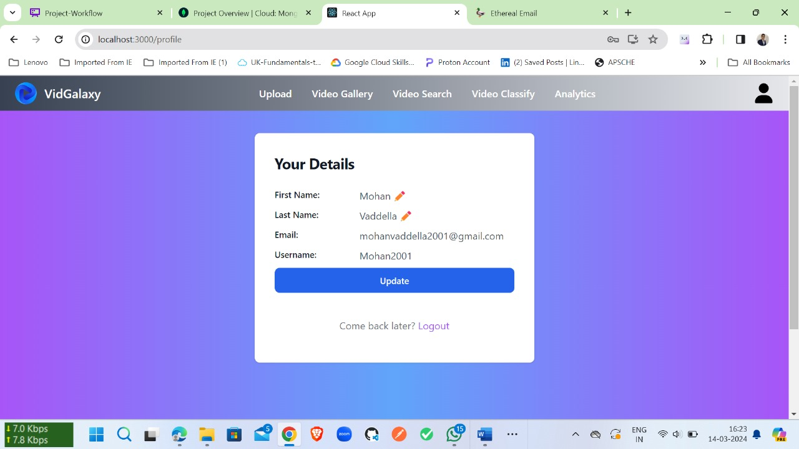
Profile

Slide 26
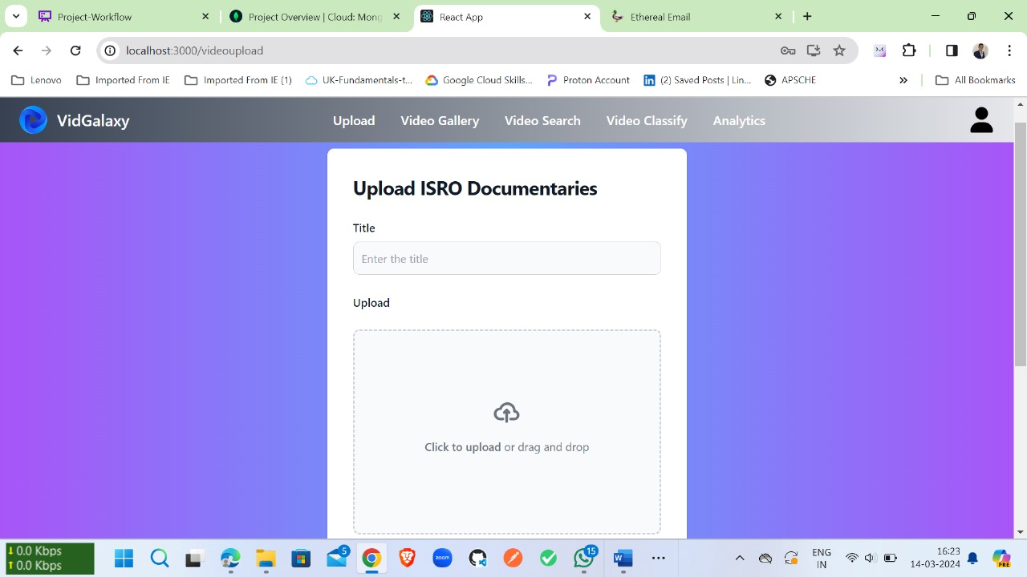
Video Upload1

Slide 27
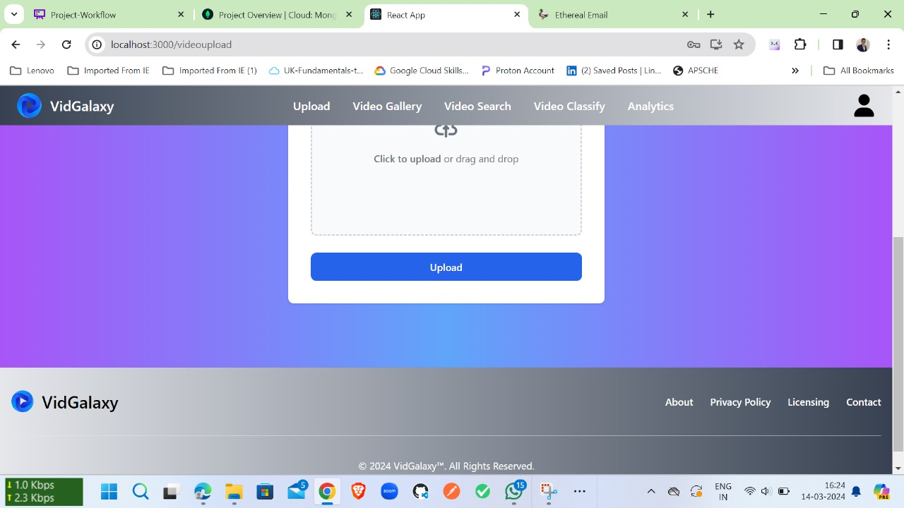
Video Upload2

Slide 28
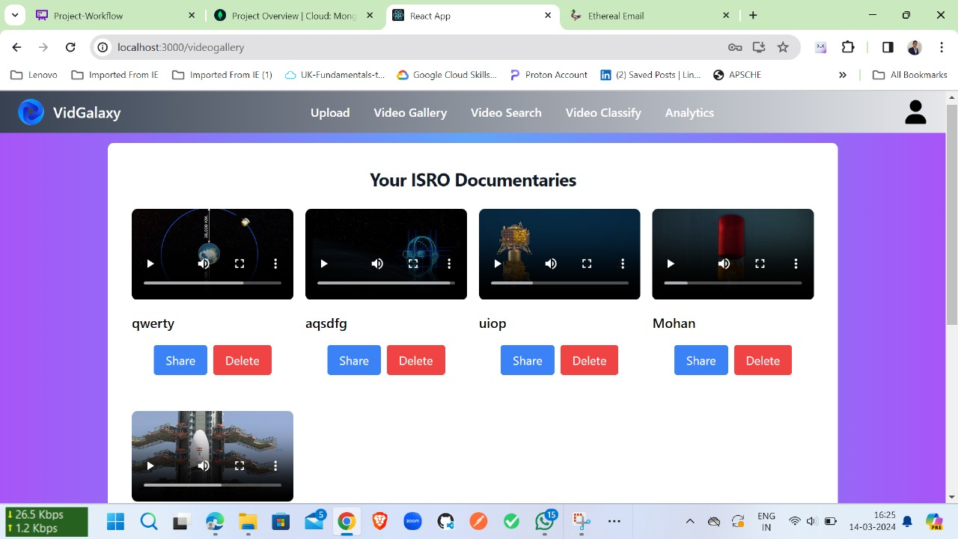
Video Gallery

Slide 29
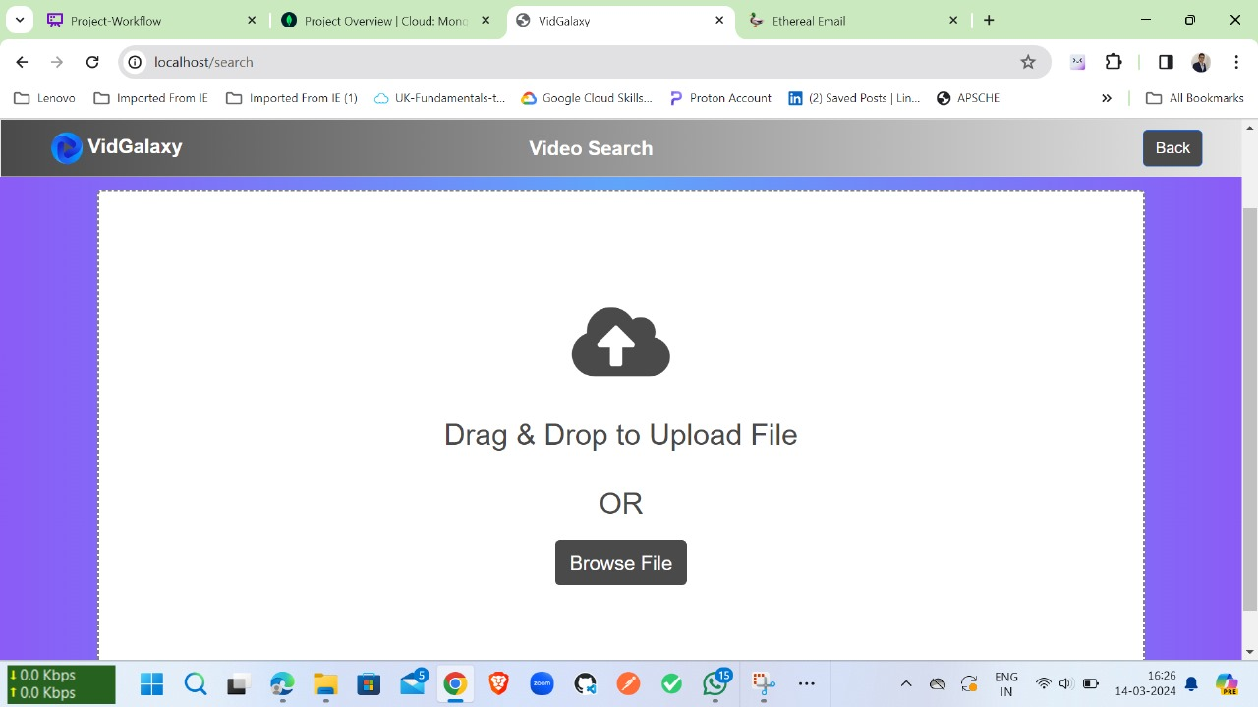
Video Search

Slide 30
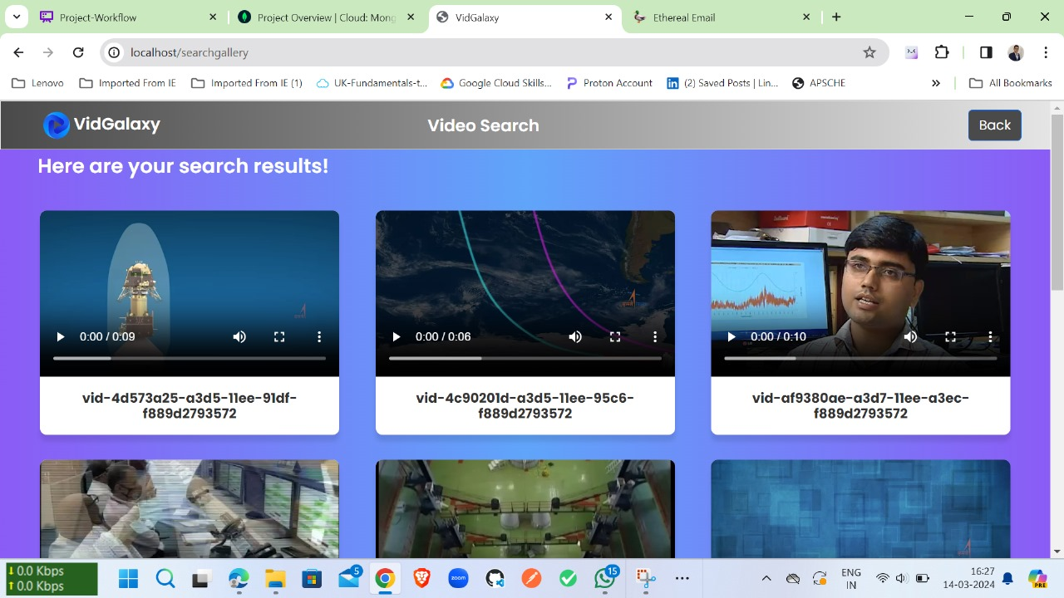
Video Search Results

Slide 31

Video Classification

Slide 32
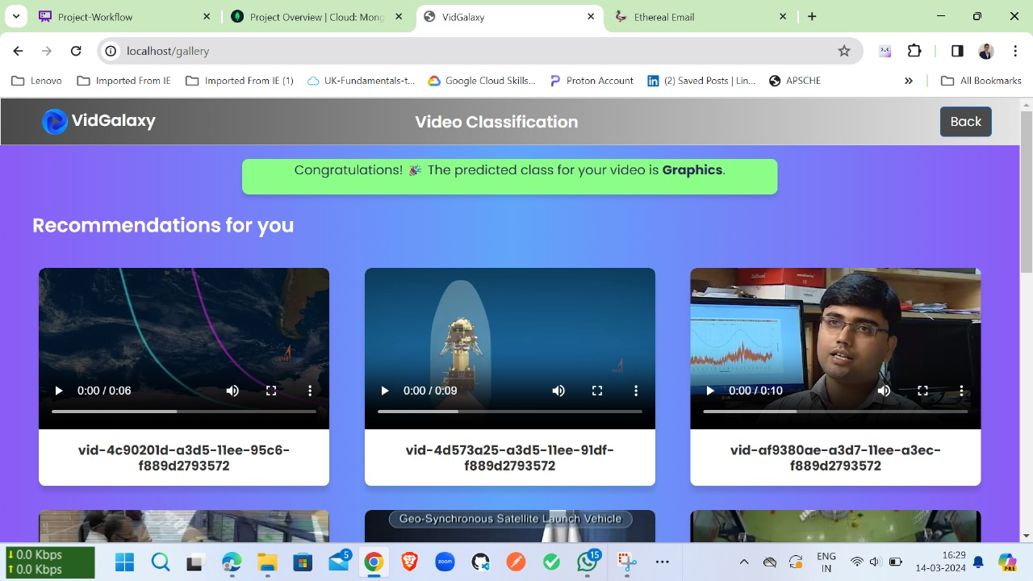
Video Classification Results

Slide 33

Video Analytics

Slide 34
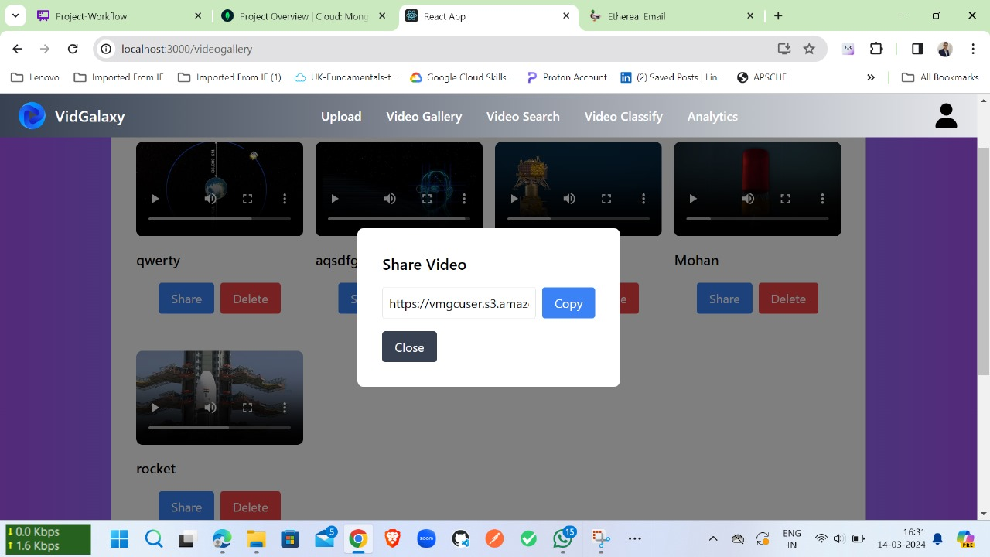
Video Share

Slide 35
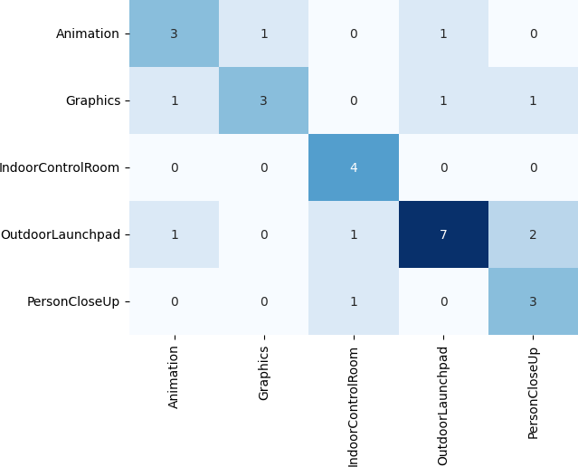
Results
Our LRCN video classification model excelled with a 67% accuracy on the ISRO dataset
Confusion matrix from classification by LRCN

Slide 36
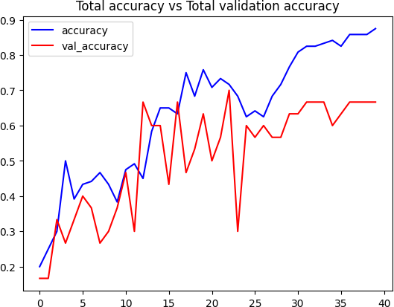
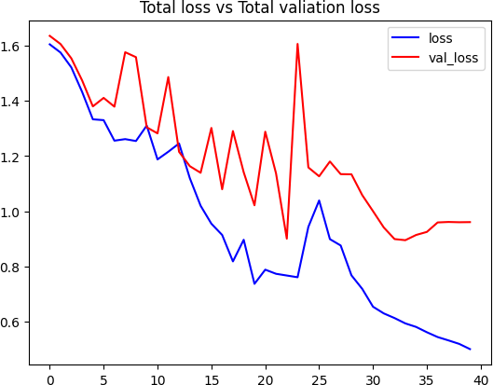
Training and Validation Loss curves demonstrate a trend, suggesting the model successfully minimized error during training and generalizes well to unseen data.
Total Accuracy vs. Total Validation Accuracy
Total Loss vs. Total Validation Loss

Slide 37
Future Enhancements
Include diverse ethnicities for broader representation and improved model accuracy in activity recognition.
Continuously expand datasets, refine models, and explore new applications to push the boundaries of video category recognition technology.
Extend the model beyond the current five categories to enhance its scope.

Slide 38
Conclusion
The LRCN model achieved a commendable accuracy of 67%, demonstrating its efficacy in video classification tasks, while the annoy algorithm proved effective for video recommendations.
Future research endeavors should focus on enhancing dataset diversity, particularly in including various ethnic backgrounds, to bolster model accuracy and advance activity recognition research.
Expansion of the model to include additional categories beyond the initial five holds promise for broader applicability and improved performance.
Practical applications of these models extend to areas like Adult content detection, offering potential solutions for content filtering and user experience enhancement.
By analyzing upcoming video frames and identifying adult content scenes, users can seamlessly skip objectionable content with a single click, enhancing user satisfaction and content accessibility.
In conclusion, continual efforts in expanding and refining datasets, improving model architectures, and exploring real-world applications aim to propel significant advancements in video category recognition technology.

Slide 39


